Slide 1
pvManager and Graphene update with tool strategy and architecture for BNL and MSU
Gabriele Carcassi - BNL

Slide 2
Architecture objectives
Architecture that can last for the next decade
  A place for everything and everything in the right place
Modularity
  Allow small contributions
  Lower the risk, compartmentalize failure
  Cooperate on parts common to other labs without forcing the whole
Allows use of coming technologies
  Multi-core
  High-resolution displays
  Tablets
  GPU

Slide 3
Publish/subscribe
v3
v4
IOC
IOC
…
IOC
IOC
…
CSS core
CSS
General purpose clients
CA client (JCA/CAJ)
pvA client
BOY
DataBrowser
Command/response
Core Java Client
…
v4
ca
pva
…
Data Sources
Masar
API
pvmanager core
Aggregation
vTypes
Data Definition
…
…
Specialized clients
graphene
Visualization
Log Viewer
AccelUtils
Channel Viewer
Web based REST services
…
ChannelFinder
API
Olog
API
WebUI, scripts, other client
Logbook
...
…
cf-update
...

Slide 4
Publish/subscribe
v3
v4
IOC
IOC
…
IOC
IOC
…
CSS core
CSS
General purpose clients
CA client (JCA/CAJ)
pvA client
BOY
DataBrowser
Command/response
Core Java Client
…
v4
ca
pva
…
Data Sources
Masar
API
pvmanager core
Aggregation
vTypes
Data Definition
…
…
NEW!
Specialized clients
formula
Processing
Log Viewer
graphene
Visualization
AccelUtils
NEW!
Channel Viewer
pvm services
Registry
Web based REST services
masar
cf
…
Bindings
…
ChannelFinder
API
Olog
API
WebUI, scripts, other client
Logbook
...
…
cf-update
...

Slide 5
New in pvmanager ca datasource
Improvements in CAJ (Gabriele + Matej)
  More efficient handling of large arrays
  More uniform to C client library
    DBE_PROPERTY support
    Variable sized array
    MAX_ARRAY_BYTES
Improvements in CA pvmanager datasource
  Encapsulate “quirks” from CA
    Value only for RTYP
    Long string support (reads VString from byte array)
    Can choose between put and put-with-callback
    Autodetects if var array is supported
  Metadata monitor
  Various bug fixes and performance improvements from usage
    Lower connection priority for large arrays

Slide 6
New in pvmanager pva datasource
Preliminary support for EPICS v4 pvAccess included with CSS
  Publish/subscribe support (no services)
Types supported:
  Scalar (VNumber, VEnum and VString)
  Array (VNumberArray and VStringArray)
  Vtable
  Matrices (VNumberArray 2D)
  Images

Slide 7
Goals for pvmanager core
Provide logic required by well-behaved application
  Queuing or caching
  Rate decoupling between subsystems (typically CA and UI, but also CA and anything else)
  Rate limiting (notification rate capped)
  Rate throttling (notification rate adapts, skips instead of building up lag)
  Shared connections (similar requests on a single monitor)
  Ability to offload work on a shared pool
You still need to understand what all of this is
You just don’t have to implement it

Slide 8
New in pvmanager core
Now the standard way to access pvs in CSS
  utility.pv being deprecated
Significant refactoring in 2.0
  Cleaner interface
  Implementation a lot more consistent
  Expressions can accept data from sources other than datasources
New features includes
  Dynamic map
    add/remove pvs, always get a single event with all values
  Channels can report properties for extra debugging information

Slide 9
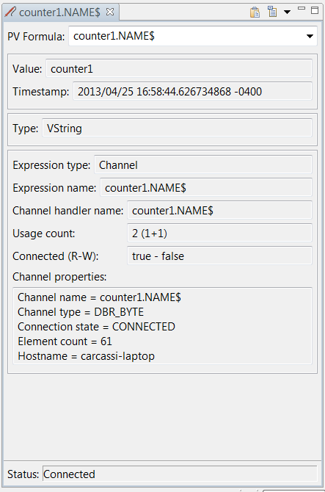
New in pvmanager core
Probe can display the extra properties
Note the long string support:
  The value is vString
  The channel type is DBR_TYPE

Slide 10
epics-util
Placeholder for utility classes that hopefully will appear in standard Java at some point
org.epics.util.array – numeric collection
  Read only view
  Allows lazy computation/functional programming
  Single binding for all numeric types instead of 6 (double, float, long, int, short, byte)
  A place for common implementation (circular buffers, sorted views, …)
org.epics.util.time – time definitions and formats
  Timestamp, TimeDuration, … while we wait for Java 8

Slide 11
New in vTypes
Control system data interfaces for Java client
Taken out of pvmanager so they can be used for services
Using numeric collections from epics-util
  Can request and work with super types VNumber, VNumberArray
Easier formatting (conversion to text)
More consistent toString implementation
First steps for exporting to CSV

Slide 12
Export vType to Excel

Slide 13
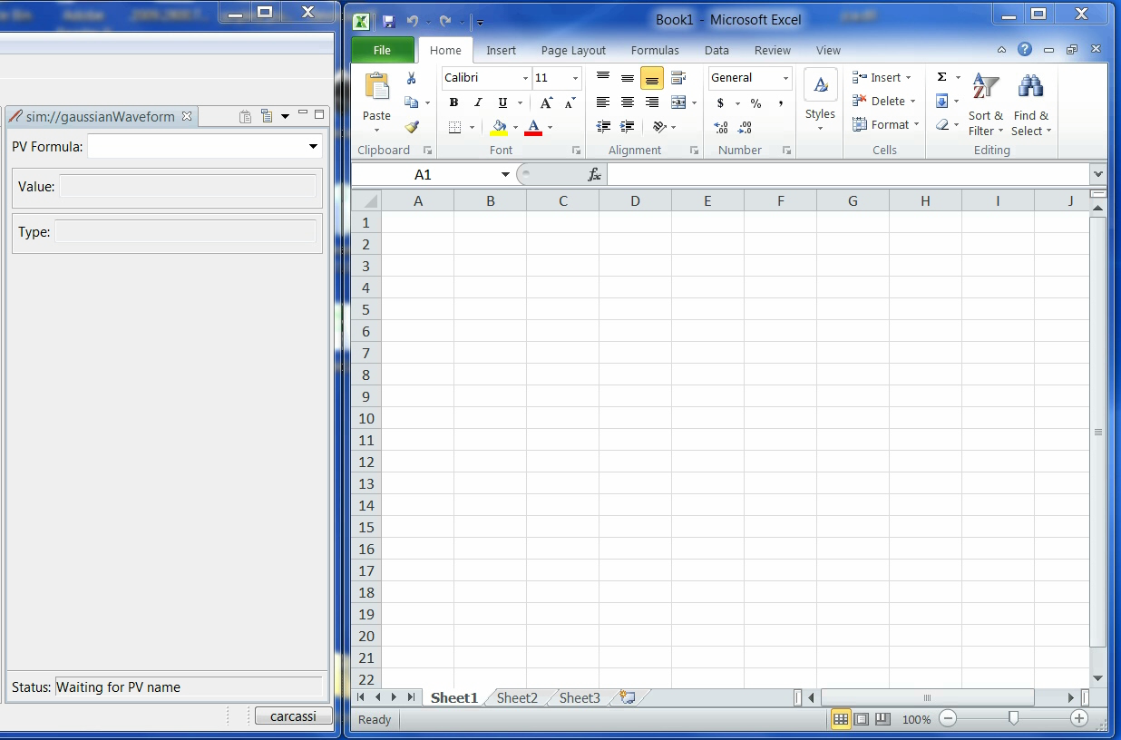

Slide 14
Goals for pvmanager formulas
Current problems:
  New type (i.e. table) or new service (i.e. channelfinder) means having to write new widgets and applications
    Difficult to extend the tools
  Each widget and application has to implement behavior that may be common, for example:
    Display the alarm/time instead of the value
    Display the value of the enum instead of the label
    Display the FFT instead of the waveform
    Display value in different unit
    Options will be slightly different, more work and code to maintain
This functionality should neither be in the datasources nor the widget
  Need a better place!

Slide 15
pvmanager formulas
Allow to specify formulas everywhere you had pvs
Currently implemented
  ‘mypv’ pvs in single quotes
  “Some text” text literals in double quotes
  3.14 numeric literals with standard C/C++/Java notation
  ‘pv1’ – ‘pv2’ standard math operators
  log(‘mypv’) functions, pluggable in CSS
  java.lang.Math methods already implemented
  arrayOf(‘pv1’, ‘pv2’, ‘pv3’) coverts scalars into arrays
  columnOf(‘tablepv’, “column1”) column from table as an array
Future possibilities
  convertUnit(‘mypv’, “m”) to meters from the unit reported by epics
  cfTable(“Tags=mytag”, “value”, “position”) table from channelfinder with live
  value and position

Slide 16
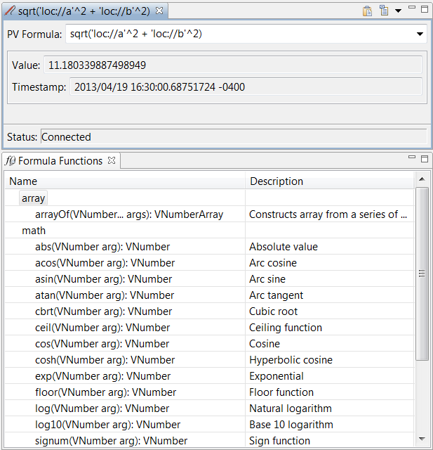
pvmanager formulas
Formula in Probe
Function viewer
lists all the
contributions
and serves as
documentation

Slide 17
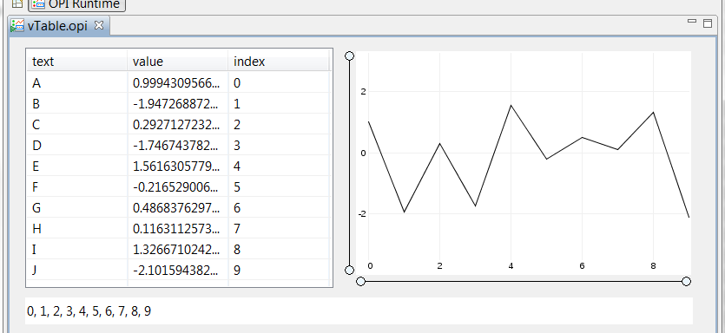
pvmanager formulas
columnOf(‘sim://table’, “value”)
value column
index column

Slide 18
pvmanager formulas
Can register functions through extension point
We expect to:
  Significantly increase the functionality
  Reduce the complexity
    Fewer widgets
    Fewer parameters per widget
  Increase consistency within CSS
If formulas become important for the whole of CSS, makes it possible to have:
  Formula editors
  Syntax coloring
  Autocomplete

Slide 19
Goals for graphene
One year ago we started working on a graph package with the following goals:
  Interfaces for datasets
  Rendering without UI
  Changes are thread-safe and atomic
  Publishable quality
  Performance suitable for “large data” in real time

Slide 20
New in graphene
Current status
  Further ahead but not as far as I’d like
  Four graphs are in decent shape:
    Scatter graph
    Line graph
    Area graph
    Bubble graph
  Common patterns are starting to drive the architecture
    Common elements to create the axis
    Common elements to handle the dynamic range

Slide 22
Graphene in CSS
Line graph and scatter graph available as:
  SWT widgets
  BOY widgets
  Independent views
Still struggling to understand what’s the best way to integrate in pvmanager/CSS/BOY
  Currently working off of arrays, does not cover all use cases
  Will probably use vTable as the input type, and provide formulas to convert from arrays and scalars to tables
    Easier to see the data points (use the table viewer)
    One columns can have text for tooltips
    Implementing import/export for vTable means the graph is supported as well
  Does not work for histogram and intensity graphs, though

Slide 23
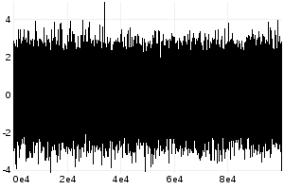

graphene performance
LineGraph performance improved through data reduction
  For each pixel draw 4 values: first, max, min, last
Displaying 100,000 points, 300x200
  How many differences can you find?
Without data reduction - 255.4 ms
With data reduction - 6.077 ms

Slide 24
graphene
Line graph, 600x400, JDK 7, i7 2.70GHz
N points | Time ms (no redux) | Time ms (redux)
10 | 0.986232349 | 0.980788919
100 | 1.924796332 | 1.872743481
1,000 | 5.553831552 | 5.345118646
10,000 | 38.57528235 | 15.73147583
100,000 | 431.8435542 | 18.28121567
500,000 | 4280.394044 | 26.20789778
1,000,000 | 15556.68846 | 36.36819781
10,000,000 |  | 257.451379
50,000,000 |  | 1178.120411
ms
N points

Slide 25
Graphene line graph demo

Slide 26
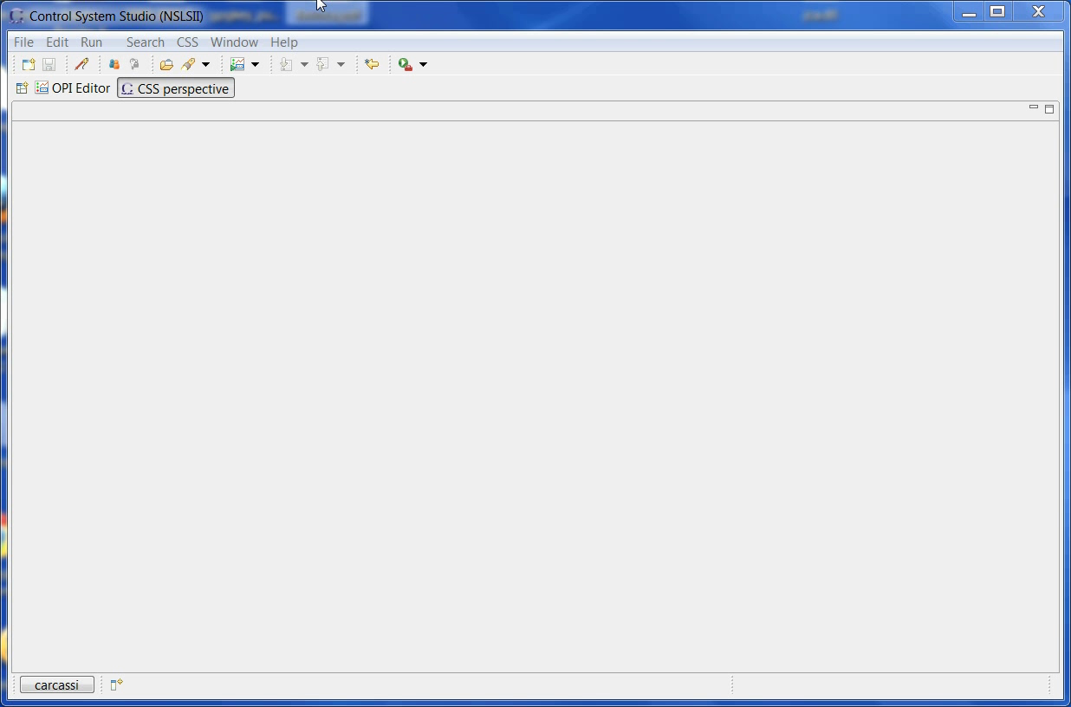

Slide 27
Goals for pvmanager services
Services cannot be integrated with standard pvmanager: a service is not a pv
  Needs parameters
  Needs someone to click send (services are not idempotent in general)
  Each client needs its own return value
  The result can be complex and may need several widgets to display
In general, you’ll need service specific APIs and applications, with specific workflow
  There is no way around it

Slide 28
Goals for pvmanager services
BUT! Some services in some cases
  Have parameters that can be expressed by vTypes (e.g. VString and VNumbers)
  Can return data that can be expressed in a vTable, vNumericArray, …
  These can be digested by general purpose clients
For example, channel finder
  Will need a specific UI to manage tags and properties
  Can export into a table the result of a query
For the general purpose only we introduce pvmanager services

Slide 29
pvmanager services
public abstract class ServiceMethod {
public String getName();
public String getDescription();
public Map<String, Class<?>> getArgumentTypes();
public Map<String, String> getArgumentDescriptions();
public final Map<String, Class<?>> getResultTypes();
public Map<String, String> getResultDescriptions();
public abstract void executeMethod(
Map<String, Object> arguments,
WriteFunction<Map<String, Object>> callback,
WriteFunction<Exception> errorCallback);
}

Slide 30
Pvmanager services demo

Slide 31
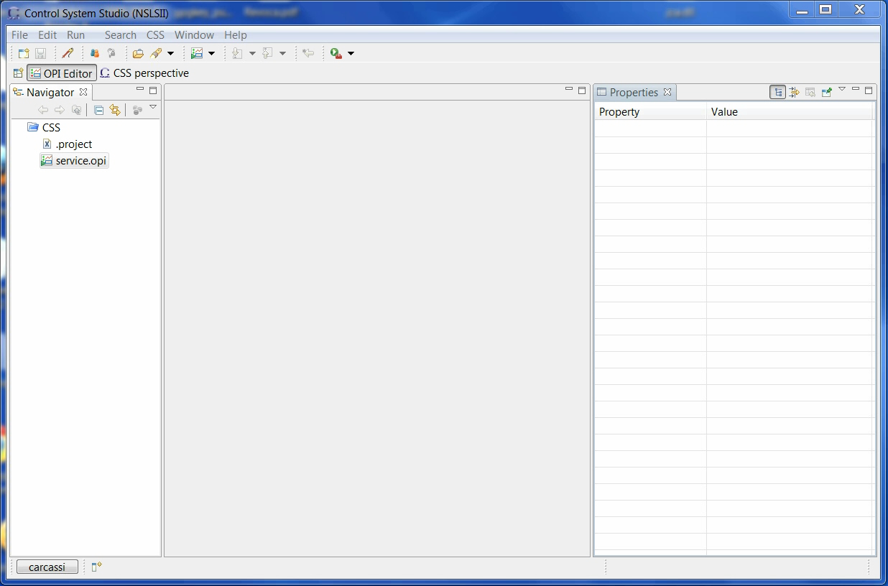

Slide 32
Framework for real time data manipulation
pvmanager datasources: pluggable sources of live data
pvmanager services: pluggable sources of static data
pvmanager formula functions: pluggable ways to combine the data
Graphene graphs: hopefully efficient way to display the data
VType export: ways to export the data
Users can now quickly and safely combine these!

Slide 33
Infrastructure
Projects are on SourceForge
  http://epics-util.sourceforge.net/
  http://pvmanager.sourceforge.net/
  http://graphene.sourceforge.net/
Built on cloudbees (Jenkins in the cloud)
  https://openepics.ci.cloudbees.com/
Libraries deployed in maven central
  http://search.maven.org/#search|ga|1|g%3A%22org.epics%22

Slide 34
Acknowledgments
Implementation
  90% Gabriele Carcassi
BUT
Ideas from many members of the Epics community
  Bob Dalesio, Ralph Lange, Micheal Davidsaver, Daron Chabot, Kunal Shroff, Eric Berriman, Matej Sekoranja, Marty Kramer, Kay Kasemir, Bastian Knerr, Murali Shankar, …
  Only their “best” ideas!
Many ideas from outside of the Epics community
  Brian Goetz, Martin Fowler, Edward Tufte, …

Slide 35
Big laundry list
There’s a lot of work that still needs to happen.
CA support can always be improved
  Integrate tests against a (mock?) IOC in JCA/CAJ/pvmanager build
  Include tests of error conditions
  Improve CA gateway
In pvmanager
  Better optimization for pure functions
  Formula compilation to bytecode
  Connection to archived data
  Data import/export
  SNMP datasource
In graphene
  Incremental graphs
  Plot with time
In CSS
  Implement formulas consistently
  Integrate various services

